Slide 1
A
Presentation
On
Rest-Assured
Presented By
Rushikesh Patil (QA Engineer)
rushikeshv.patil@infobeans.com

Slide 2
Agenda
What is API .
What is API Testing?
What is Rest Assured?
Advantages of Rest Assured.
Disadvantages of Rest Assured.
Ecommerce API Application

Slide 3
What is API
API stands for Application Programming Interface.
It comprises a set of functions that can be accessed and executed by another software system.
Thus, it serves as an interface between different software systems and establishes their interaction and data exchange.
Example:
Google APIs are application programming interfaces (APIs) developed by Google which allow communication with Google Services and their integration to other services. Examples of these include Search, Gmail, Translate or Google Map

Slide 4
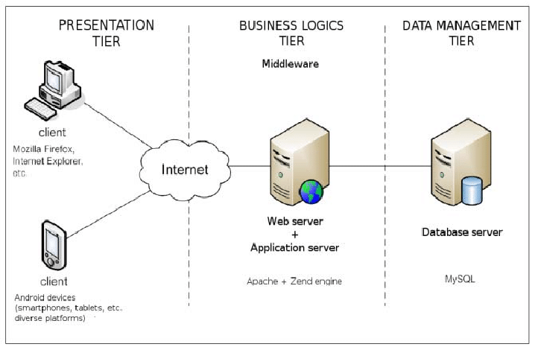
What is API Testing?
In API testing we send requests (method calls) to the API and get output (responses).
These APIs are generally REST APIs or SOAP web services with JSON or XML message payloads being sent over HTTP, HTTPS, JMS, and MQ.

Slide 5
What is Rest Assured?
REST Assured is a Java library that provides a domain-specific language (DSL) for writing powerful, maintainable tests for RESTful APIs.
We can create highly customize-able HTTP Requests to send to the Restful server.
This enables us to test a wide variety of Request combinations and in turn test different combinations of core business logic.
Rest-Assured library also provides the ability to validate the HTTP Responses received from the server. For e.g. we can verify the Status code, Status message, Headers and even the Body of the response

Slide 6
Advantages of Rest Assured
1 It is open-source and hence free to use.
2 It is very rich in syntax and ready-made assertions. Rest Assured requires less coding as compared to Apache HTTP Client.
3 The setup of Rest Assured is easy and straightforward.
4 The response is given in JSON or XML format and is easy to parse and validate.
5 It uses inbuilt Hemcrest Matchers for easy extraction of values.
6 Response time is quick as also an assertion of status code.
7 The library has a powerful logging mechanism. Also, we can verify headers, cookies, content type, etc on the fly.
8 It can easily be integrated with other Java libraries like TestNG, JUnit, etc. We can also integrate it with Selenium-Java and achieve end-to-end automation.

Slide 7
It can easily be integrated with other Java libraries like TestNG, JUnit, etc. We can also integrate it with Selenium-Java and achieve end-to-end automation.
9 It has very good support for various API authentication mechanisms.
10 It supports JsonPath and XmlPath that helps in parsing JSON and XML response. It also has support for the JSON Schema Validation library to verify JSON Schema.
11 Rest Assured can also be integrated with Maven and CICD.
12 It supports multi-part form data
13 Supports Spring Mock MVC, Spring Web Test Client, Scala, and Kotlin.
14 It follows the BDD (Behavioural Data-Driven) approach and keywords like given() when(), then() which makes code readable and supports clean coding.

Slide 8
Disadvantages of Rest Assured
It does not support the testing of SOAP(Simple Object Access Protocol) APIs explicitly.
Using this library requires that the user has good Java programming knowledge.
There is no inbuilt reporting in Rest Assured.

Slide 9
Rest-Assured Program Syntex
Given().
param("x", "y").
header("z", "w").
when().
Method().
Then().
statusCode(XXX).
body("x, ”y", equalTo("z"));

Slide 10
E-Commerce API Application
End to End Flow
Login API -> Create Product -> Purchase Order on created Product -> View order -> Delete Product
API
1 Login API -Method-Post
2 Create Product-Method -Post
3 create-Order-Method-Post
4 View-Order-Method-Get
5 Delete Product-Method-Delete

Slide 11


Slide 12


